Slide 1

Vital Events Canada and the Impact of a Public Health Crisis
Katie Schilling
501130072
Supervisor: Tamer Abdou, PhD

Slide 2
Glimpse of Data: Vital Events Canada
Date | Births | Marriages | Deaths | Stillbirths
1994-01-1 | 11631 | 2078 | 8094 | 75
1944-02-1 | 11254 | 2650 | 6428 | 62
1944-03-1 | 13003 | 2557 | 6503 | 73
1944-04-1 | 12576 | 3967 | 6224 | 74
1994-05-1 | 13240 | 6493 | 6483 | 67
1994-06-1 | 13072 | 7754 | 6187 | 66

Slide 3
Glimpse of Data: Covid-19
Date | Covid
2020-02-1 | 11
2020-03-1 | 8533
2020-04-1 | 44688
2020-05-1 | 37711
2020-06-1 | 13257
2020-07-1 | 12108

Slide 4
Glimpse of Data: Vital Events Canada & Covid-19
Date | Births | Marriages | Deaths | Stillbirths | Covid
1994-01-1 | 11631 | 2078 | 8094 | 75 | 0
1944-02-1 | 11254 | 2650 | 6428 | 62 | 0
1944-03-1 | 13003 | 2557 | 6503 | 73 | 0
1944-04-1 | 12576 | 3967 | 6224 | 74 | 0
1994-05-1 | 13240 | 6493 | 6483 | 67 | 0
1994-06-1 | 13072 | 7754 | 6187 | 66 | 0

Slide 5
Research Questions
Are there any alarming trends, or changes in variables that show an impact on either the growth or decline of the vital events, that are apparent when visualizing the data?
When analyzing the vital events data, using forecast for time series, what is the trend, prior to adding in the occurrence of COVID-19?
When looking at the overall data, and plotting it as a time series, is there a trend of steady decline in stillbirths, as our knowledge and medical advancements are made?
Based on history, what numbers did we expect to see in 2020 and 2021? How did those numbers differ with the introduction of COVID-19?
Is there any causality between the variables, when compared both individually to one another, and when comparing one variable to the remaining?
What does this analysis tell us about the data, and its ability to predict future trends, when all the data is used in conjunction to one another? Was there any indication that there was an impending public health crisis emerging?

Slide 6
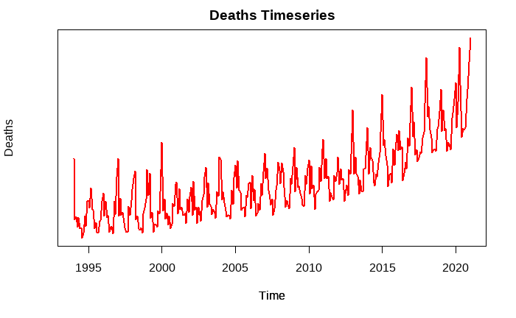
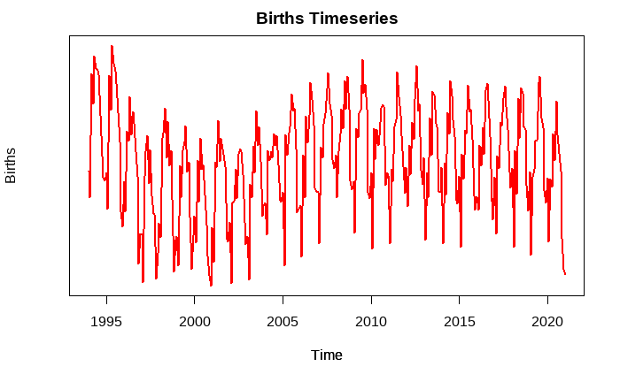
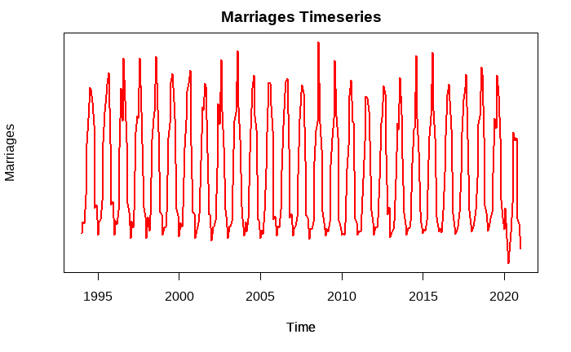
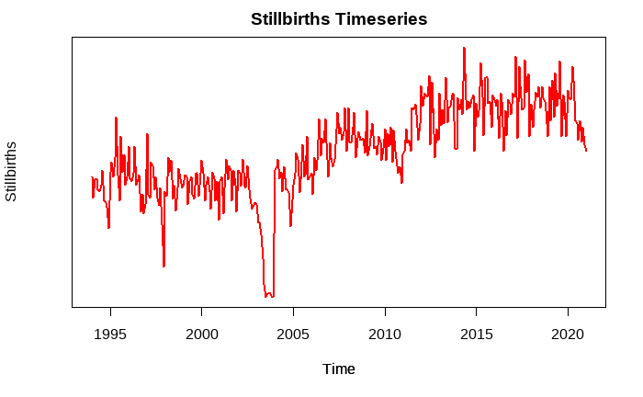
Visualizing the Data and Existing Trends
Deaths show a steady increase
Births show a stable trend
Marriages is consistent other than a lower high in 2020
Stillbirths shows some volatility but is on a steady incline, rather than a decline one might expect to see with medical advancements.
Overall data seems to be consistent with historical data, with some volatility as we enter 2020.
From visualizing the data, there does not appear to be any alarming trends except for the steep decline in marriages.

Slide 7
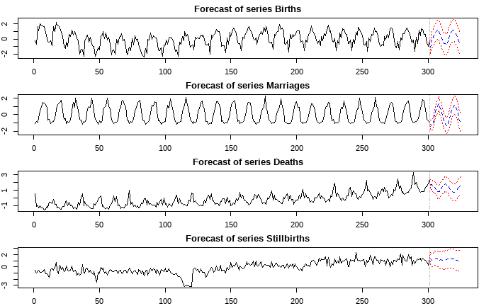
Vital Events Prediction 2020-2022
Overview of the predictions for each variable based on historical data.
Predictions are for 2020-2022 to better analyze predicted values, when compared to actual values with Covid-19 introduction

Slide 8
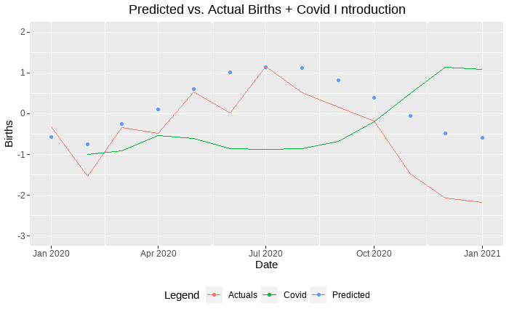
Actual Births vs. Predicted Births
Starting with births, we can see that the predicted values vs. actual values for 2020-21 start out relatively stable, however as we see the number of COVID-19 cases increase, we also see the variance between predicted and actual grow. This would indicate that there is some causality, as it appears COVID-19 has some impact on the number of births

Slide 9
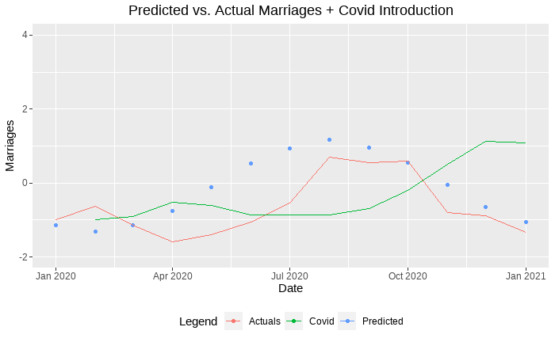
Actual Marriages vs. Predicted Marriages
Next, when looking at Marriages, the variance between actuals and predicted values seems to be stable. Even with the introduction of COVID-19. While the initial introduction of COVID-19 does seem to play some part in the variance, as you look towards the end of the chart where COVID-19 numbers are the highest, there is vary little variance between the predicted and actual values. This would indicate that initially there may have been some causality between marriages and covid-19, or indication that one might affect the other, it stabilized and no longer appears to be a factor

Slide 10
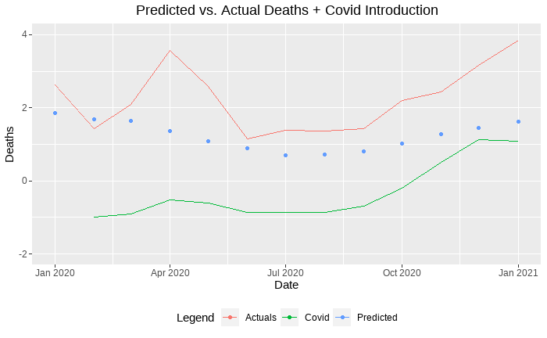
Actual Deaths vs. Predicted Deaths
When looking at deaths, predicted vs. actual values we can see that the variance starts off relatively stable, and then there is a large variance when there is the first slight increase in COVID-19. When COVID-19 stabilizes, so does the variance between actual and predicted values. The further we look, as COVID-19 numbers increase so does the variance between predicted and actuals. Again, this would assume some causality between deaths and COVID-19.

Slide 11
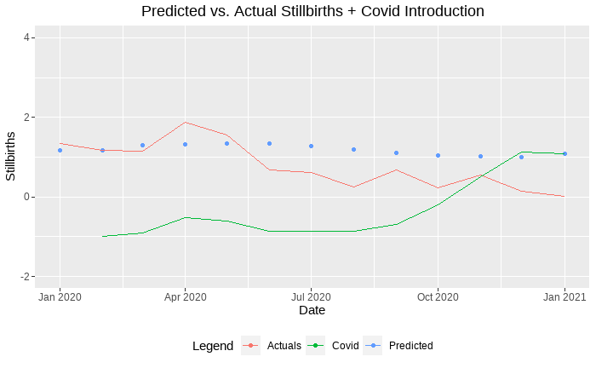
Actual Stillbirths vs. Predicted Stillbirths
Finally, when looking at Stillbirths actual values vs. predicted values, this is the most stable variable. The variance between predicted and actual is minimal in comparison and shows no indication that there is causality between stillbirths, and COVID-19.

Slide 12
Granger Causality
Granger Test | Deaths | Births | Marriages | Stillbirths
F-Test | 5.7512 | 9.293 | 14.545 | 4.1624
Df1 | 18 | 18 | 18 | 18
Df2 | 1084 | 1084 | 1024 | 1084
p-value | 2.627e-13 | 2.2e-16 | 2.2e-16 | 1.407e-08
In the initial granger causality test, and 1 vs all approach was taken. The results provided on the table is the results for each variable when weighed against all other variables at the same time
Results
No causalities found
No instantaneous causalities found

Slide 13
Granger Causality 1 v. 1
Granger Test Marriages | F | Pr(>F) | Significance
Marriages ~ Births | 4.2563 | 3.291e-06 | ***
Marriages~ Deaths | 9.9338 | 2.624e-16 | ***
Marriages ~ Stillbirths | 2.9507 | 0.000677 | ***
Marriages ~ Covid | 22.364 | 2.2e-16 | ***
Granger Test Stillbirths | F | Pr(>F) | Significance
Stillbirths ~ Births | 4.3946 | 1.85e-06 | ***
Stillbirths ~ Marriages | 4.5966 | 7.962e-07 | ***
Stillbirths ~ Deaths | 4.63 | 6.926e-07 | ***
Stillbirths ~ Covid | 1.4109 | 0.1597
All variables in Marriage have a strong significance in the causality test.
Covid shows no significance in causality report. All others show a strong significance

Slide 14
Granger Causality 1 v. 1
Granger Test Deaths | F | Pr(>F) | Significance
Deaths ~ Births | 7.4423 | 5.739e-12 | ***
Deaths ~Marriages | 6.7127 | 1.16e-10 | ***
Deaths ~ Stillbirths | 2.1829 | 0.01257 | *
Deaths ~ Covid | 5.9415 | 2.869e-09 | ***
Most variables associated with death show significance, with Stillbirths having the weakest significance
Granger Test Covid | F | Pr(>F) | Significance
Covid ~ Deaths | 1.6482 | 0.7796 | .
Covid ~Marriages | 1.803 | 0.04714 | *
Covid ~ Stillbirths | 1.6179 | 0.08576 | .
Covid ~ Births | 2.7104 | 0.7079
Granger Test Births | F | Pr(>F) | Significance
Births ~ Deaths | 4.8443 | 2.82e-07 | ***
Births ~Marriages | 9.9338 | 2.624e-16 | ***
Births ~ Stillbirths | 2.7585 | 0.001439 | **
Births ~ Covid | 2.7104 | 0.001734 | **
All variables, when analyzed against covid show very little levels of significance. This is likely due to the lack of historical data, and the unexpectedness of it
All variables in births have a relatively strong significance in the causality test.

Slide 15
Causality Key Points
Strong significance overall when analyzing variables against one another one at a time.
Strongest significance:
Deaths ~Births, Deaths~Marriages, Deaths~Covid
Births~Deaths, Births~Marriages
Marriages~Births, Marriages~Stillbirths, Marriages~Deaths, Marriages~Covid
Stillbirths~Births, Stillbirths~Marriages, Stillbirths~Deaths
Marriages has the overall strongest significance indicating if you know the values of Marriages you are better able to predict the values of the other variables.
When analyzing 1 vs. all no causality can be found
Neither in general or instantaneous

Slide 16
Key Take-away Points
Causality is strong when compared 1 v. 1 rather than 1 v. all
Overall trends of the vital events data remained relatively stable
More information, and historical data needed to further examine the impact of Covid-19 on vital events more thoroughly.
Further research, and more in depth analysis, once more data is available may lead to being able to better predict the onset of a public health crisis.
This analysis covered primarily the impact of Covid-19 on our vital events, however, we can also use the same approach with other possible impacts such as:
Mental health
Suicide rates
Homelessness
Poverty
Predicted vs Actual values for 2020-2021 have a higher level of variation than would have been expected.
Assumption is the introduction of Covid-19 played a key role in the difference.

Slide 17
References
Elias, B. (2014, October 30). Moving beyond the historical quagmire of measuring infant mortality for the first nations population in Canada. Social Science & Medicine. Retrieved April 4, 2022, from https://www.sciencedirect.com/science/article/pii/S0277953614007096
Government of Canada, S. C. (2020, April 8). Frequently asked questions on vital statistics. Government of Canada, Statistics Canada. Retrieved April 4, 2022, from https://www.statcan.gc.ca/en/about/relevant/vscc/faq
What now?: Canada health transfer: Background and future: Canada west foundation. Canada West Foundation |. (2021, September 8). Retrieved April 4, 2022, from https://cwf.ca/research/publications/what-now-canada-health-transfer-background-and-future/
Shah, P. S., Ye, X. Y., Yang, J., & Campitelli, M. A. (2021, August 3). Preterm birth and stillbirth rates during the COVID-19 pandemic: A population-based Cohort Study. CMAJ. Retrieved April 4, 2022, from https://www.cmaj.ca/content/193/30/E1164
Ontario population projections. ontario.ca. (n.d.). Retrieved April 4, 2022, from https://www.ontario.ca/page/ontario-population-projections
Canada, P. H. A. of. (2021, May 28). Covid-19 Daily Epidemiology update. Canada.ca. Retrieved April 4, 2022, from https://health-infobase.canada.ca/covid-19/epidemiological-summary-covid-19-cases.html
Government of Canada, Statistics Canada. (2021, December 22). This summary provides an update on the work the agency has and is undertaking using existing and new data sources to provide critical insights on the social and economic impacts of covid-19 on Canadians. it includes data from fall 2021. Government of Canada, Statistics Canada. Retrieved April 4, 2022, from https://www150.statcan.gc.ca/n1/pub/11-631-x/11-631-x2021003-eng.htm
Government of Canada, S. C. (2021, October 4). Survey on covid-19 and mental health, February to May 2021. The Daily - . Retrieved April 4, 2022, from https://www150.statcan.gc.ca/n1/daily-quotidien/210927/dq210927a-eng.htm
Wikimedia Foundation. (2022, April 2). Timeline of the covid-19 pandemic in Canada. Wikipedia. Retrieved April 4, 2022, from https://en.wikipedia.org/wiki/Timeline_of_the_COVID-19_pandemic_in_Canada

